Slide 1
Reflection on Java Programming (Weeks 1-6)
By Dominic Bumpus, CS—5103, 02/22/2026

Slide 2
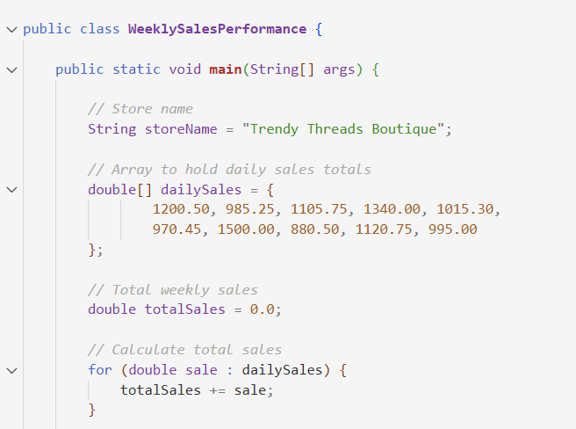
Introduction
What does this presentation cover?
Topics Covered
Programs Created
How has this improved my confidence with Java?

Slide 3
Core Concepts
Classes and Objects
Variables and Data Types
Decision-Making and Loops
Methods and Parameters

Slide 4
Challenges and Solutions
A Challenge I faced
What got me through it
What this taught me

Slide 5
Applying Java Concepts
Using Arrays, Strings, and Math Functions
Organizing Logic with Methods
Writing Clean, Reuseable Code

Slide 6
Encapsulation and Access Modifiers
What is Encapsulation And Why Is It Important?
How do Access Modifiers Keep Data Secure?
An Example of Using Getters and Setters

Slide 7
Reflection
What Was The Most Rewarding Part of Learning Java?
How has the Problem-Solving Approach Evolved Throughout This Course?
What would I do Differently Now?

Slide 8
Real-World connection
A Real World Application of Java
Topics in Java That Could Translate to a Career

Slide 9
Conclusion
My Overall Learning Journey
Final Thoughts

Slide 10
Thank You

